Slide 1
Timing Workshop
Ljubljana, September 20, 2022

Slide 2
Micro-Research Finland Oy
Micro-Research Finland Oy -
Company Introduction
MRF founded in 1985
Hardware development (and firmware/software)
History of
  VME bus products
  Data acquisition
  Fibre Optic data transmission
  Embedded microcontroller systems
    Motor control/Control system for a lab printing machine
  Sensor to analyse printing quality for paper
Current focus since 1999 on timing systems for particle acceleratos

Slide 3
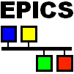
Micro-Research Finland Oy
MRF Timing System Development
The MRF Timing system originally developed for the Swiss Light Source (SLS), Paul-Scherrer Institute in 1999
First commercially available timing system for particle accelerators
Current users include:
  SLS, PSI, Switzerland
  Diamond Light Source Ltd., U.K.
  SSRF, Shanghai, China
  Australian Synchrotron
  ALBA, Spain (Tango)
  Elettra, Trieste, Italy (Tango)
  BEPCII, Insitute for High Energy Physics, Beijing, China
  LCLS, Stanford Linear Accelerator Center, USA
  KEK, Japan
  FERMI, Trieste, Italy (Tango)
  TLS, Taiwan
  KIT, Germany
  NSLS II, Brookhaven, USA
  PAL-XFEL, Pohang, South Korea
  LANSCE upgrade, Los Alamos, USA
  FRIB, Michigan, USA
  SwissFEL, PSI, Switzerland
  STFC, Daresbury, U.K.
  ESS, Sweden
  APS-U, Argonne National Lab, USA
  ELBE, HZDR, Germany
  Bessy II, Germany
Most of the sites listed above are using EPICS
jukka.pietarinen@mrf.fi

Slide 4
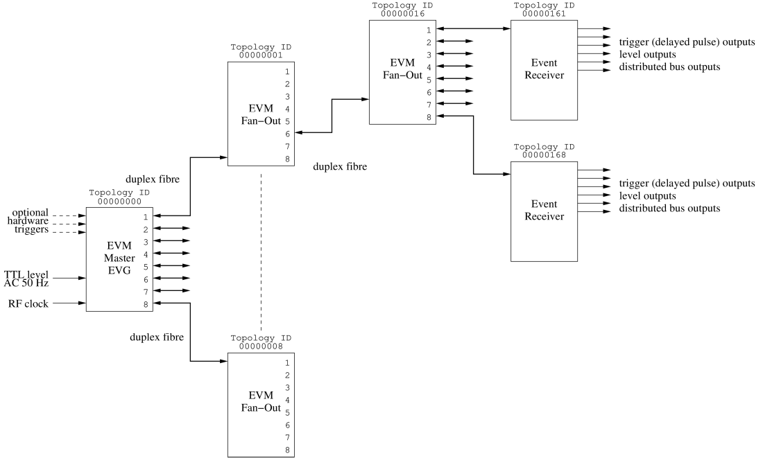
Typical System Layout - Delay Compensation (DC)
Event link protocol carries:
8 bit event codes @ event rate max. 167 MHz
8 bit distributed data bits @ ½ event rate
Data buffer transfers up to 2 kbyte
Segmented data buffers up to 128 x 16 bytes
Max. data transfer rate 83 Mbytes/s

Slide 5
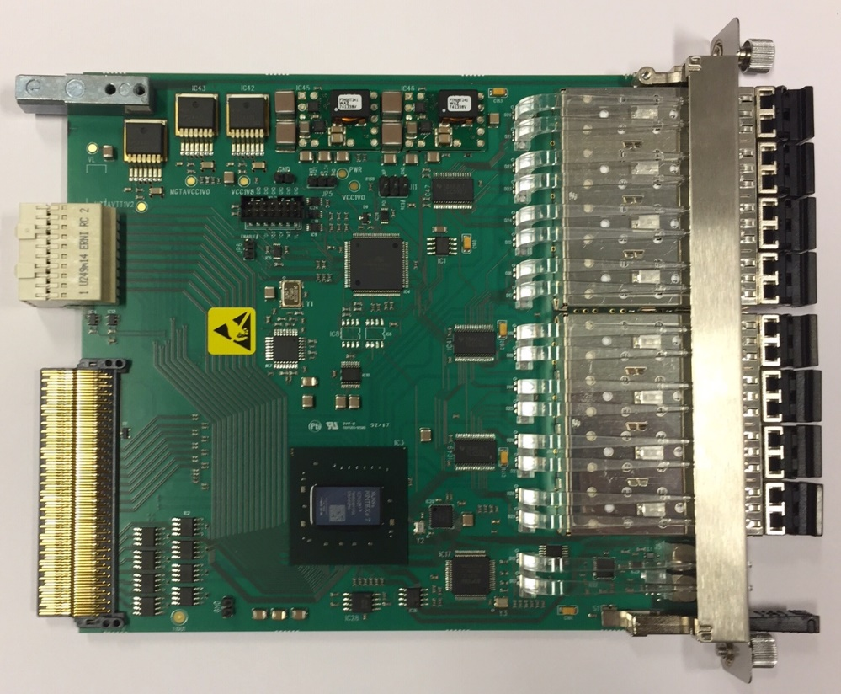
mTCA-EVM-300
Event Generator (EVG)
  2 sequencers with maskable events
    Max. 2047 events/sequence
    32 bit timestamp
  8 multiplexed counters
  data buffer up to 2k bytes
  segmented data buffer
    127 segments, 16 bytes each
7-Way Fan-Out/Concentrator
Two Event Receivers (EVR)
  8 internal pulse outputs
  one sequencer
Event rate conversion (with some data buffer related limitations)
Front panel input phase monitoring/select features
Distributed bus phase selection
RF input monitoring
Support for rear transition module

Slide 6
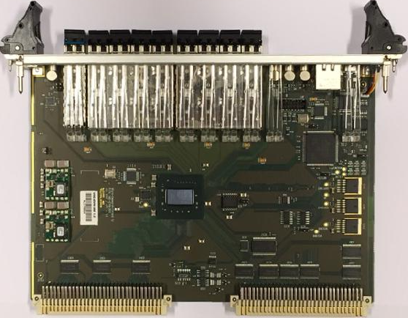
Micro-Research Finland Oy
VME-EVM-300
VME64x
Event Generator
8-Way Fan-Out / Concentrator
Event clock up to 142,9 MHz (room for improvement left)
Integrated Fan-Out Concentrator and Event Generator
  Reference clock from RF input or recovered clock from upstream EVM
  Allows for fully synchronized downstream EVGs
Masked events in Sequencer
  Hardware or software mask/enable
Segmented Data Buffer
  128 segments of 16 bytes each (2 kbyte buffer)

Slide 7
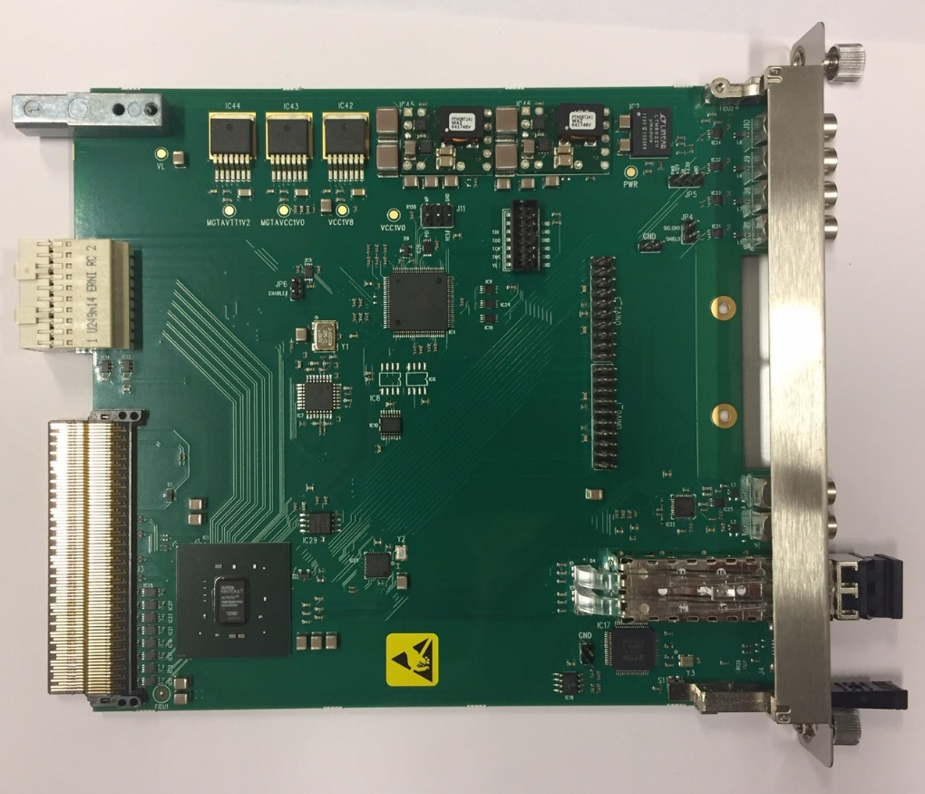
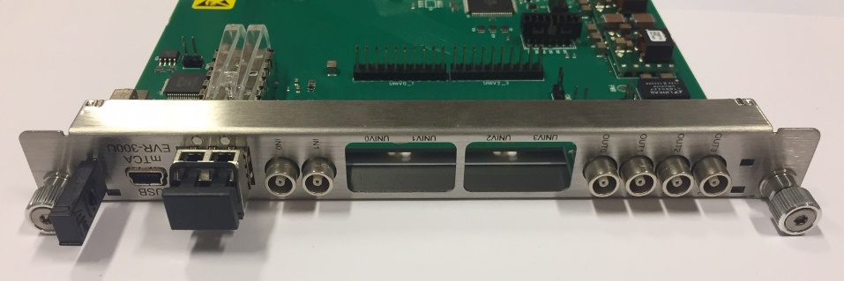
Micro-Research Finland Oy
mTCA-EVR-300U
Event Receiver (EVR)
Two Universal I/O slots
  both compatible with -DLY modules
Four LVTTL outputs
Two TTL inputs for external triggers
Backplane triggers
Can drive TCLKA/TCLKB clocks with GTX logic
RTM interface
New mTCA-EVR-300U on the way
  Fixed low amplitude on differential backplane triggers

Slide 8
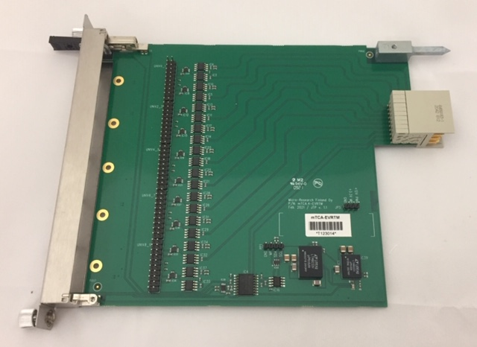
Micro-Research Finland Oy
mTCA-EVRTM-300
Supports up to 5 Universal I/O Modules
Up to ten inputs or outputs
Can be used for mTCA-EVM-300, mTCA-EVR-300U and mTCA-EVR-300RF
Supports –DLY modules

Slide 9
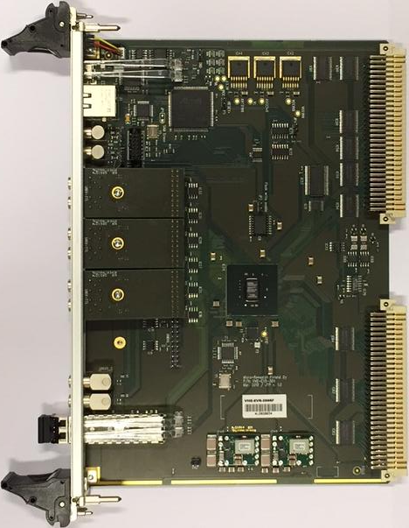
Micro-Research Finland Oy
VME-EVR-300
VME64x
Event Receiver
Four Universal I/O Slots (one slot driven by GTX)
Two differential CML outputs (GTX)
Two TTL inputs with default state selectable with jumpers
Optional transition board VME-UNIV-TB64x
Pulse Generator Triggers from prescalers and DBUS bits
Gated pulse outputs
Dual output mapping registers
Segmented Data Buffer

Slide 10
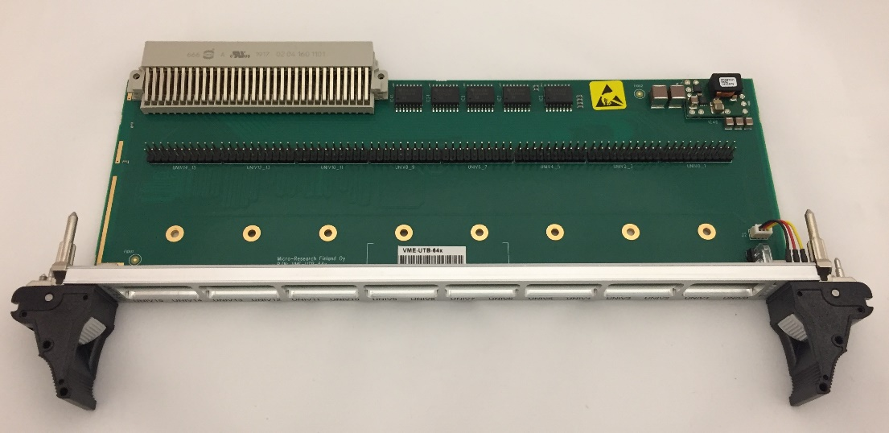
Micro-Research Finland Oy
VME-UTB-64x
VME-UTB-64x new transition board replacing obsolete VME-UNIV-TB64x
Support for Universal I/O modules requiring GPIO (VME-EVR-300 only)
  UNIV-LVPECL-DLY
  UNIV-TTL-DLY
Added status LEDs (VME-EVR-300 only)
  Link / Violation / Event in / Event out
Compatible also with older HW (230 series), only new features are not supported
Power both through front board and backplane +5V pins

Slide 11
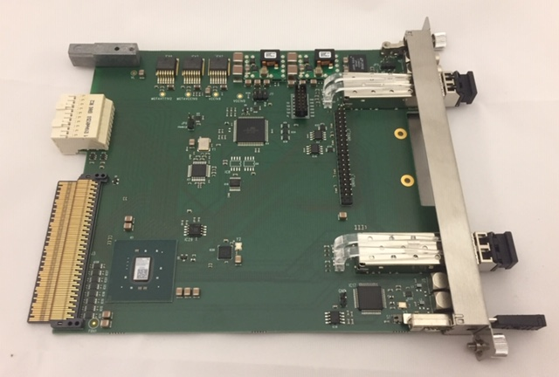
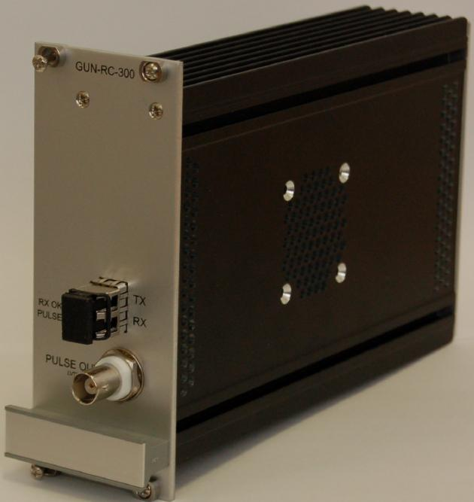
Micro-Research Finland Oy
mTCA-EVR-300RF / GUN-RC-300
Event Receiver (EVR)
Two Universal I/O slots
  both compatible with -DLY modules
  One slot driven by two GTX outputs
One SFP Output for GUN-RC-300
One Differential CML Output (GTX)
Two TTL inputs for external triggers
Backplane triggers
Can drive TCLKA/TCLKB clocks with GTX logic
RTM interface
Optical connection to EVR
One 5V TTL output
Supplied by 9-36 V
Can be mounted in high voltage rack

Slide 12
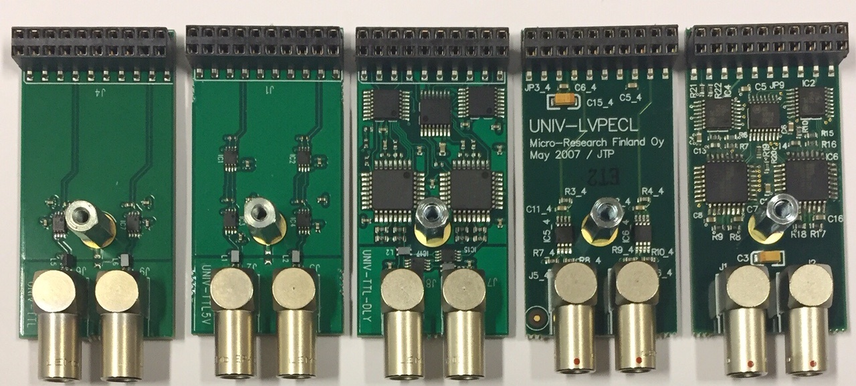
Micro-Research Finland Oy
Universal I/O Modules
UNIV-TTL
  LVTTL output
UNIV-TTL5V
  5V TTL output
UNIV-TTL-DLY
  LVTTL output
  Delay tuning 1024 steps of ~9 ps
UNIV-LVPECL
  differential LVPECL output
UNIV-LVPECL-DLY
  differential LVPECL output
  Delay tuning 1024 steps of ~9 ps
UNIV-TTL
UNIV-TTL5V
UNIV-TTL-DLY
UNIV-LVPECL
UNIV-LVPECL-DLY

Slide 13
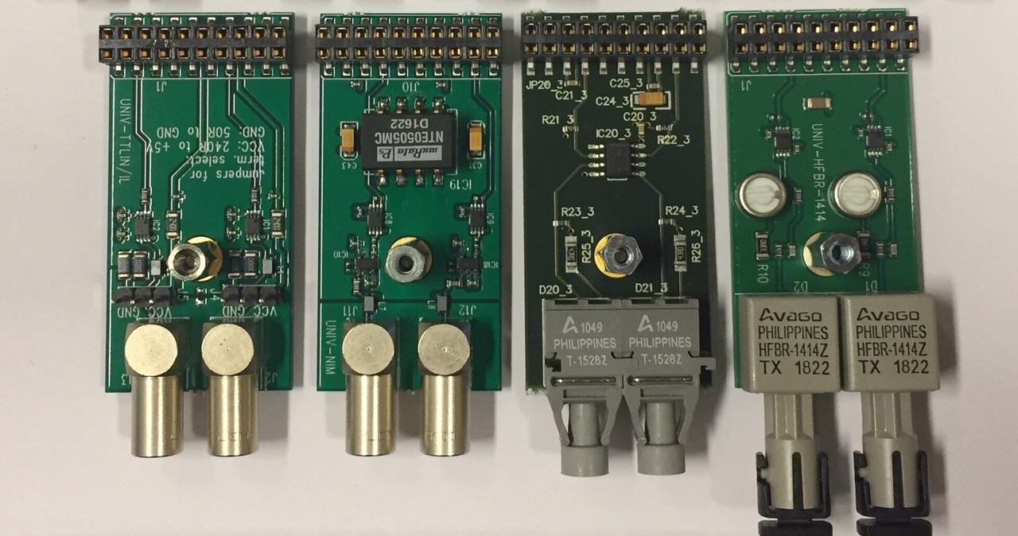
Micro-Research Finland Oy
Universal I/O Modules
UNIV-TTLIN/IL
UNIV-NIM
UNIV-HFBR-1528
UNIV-HFBR-1414
UNIV-TTLIN
  TTL input
  configurable term.
    240 ohm to +5V
    50 ohm to GND
UNIV-NIM
  NIM output
UNIV-HFBR-1528
  Optical Output
UNIV-HFBR-1414
  Optical Output

Slide 14
Micro-Research Finland Oy
Global shortage of semiconductors
Global shortage of semiconductors
  Parts availability has been getting worse
  Lead times to up to 66 weeks
  Allocation
  Price increases
Serious delays, with no improvement visible
Initially only certain parts affected, but now almost everything is hard to obtain
We could keep up to ~spring this year
Now, running out of stock on almost everything
  Next year does not look good

Slide 15
Micro-Research Finland Oy
SAM3X Microcontroller Firmware for VME-EVR-300 and VME-EVM-300
Similar ethernet support as for the VME 230 series
  Telnet access
  UDP Port 2000 access, read/write EVR/EVM registers directly
  10/100 ethernet and DHCP
  Allows using EVR/EVM in VME systems without CPUs
Open source
Available on github https://github.com/jpietari/VME-SAM3X

Slide 16
Micro-Research Finland Oy
Example of mTCA-EVM Custom Firmware for ELBE (HZDR)

Slide 17
Micro-Research Finland Oy
Example of mTCA-EVM Custom Firmware for NICA
Implementation of ”automatic” shared memory
Added configurability to EVM data packet routing:
  Loopback data packets from EVRs to EVRs
  Forward data packets upstream (to upstream EVM)
  Fan-out data packets downstream (to EVRs)
  Fan-out local data packets downstream (to EVRs)

Slide 18
Micro-Research Finland Oy
Discussion
Questions?
Timing issues?
New requests/requirements?

