Slide 1
MRF latest developments
Timing Workshop
EPICS Collaboration Meeting
CEA Saclay
April 23, 2026

Slide 2
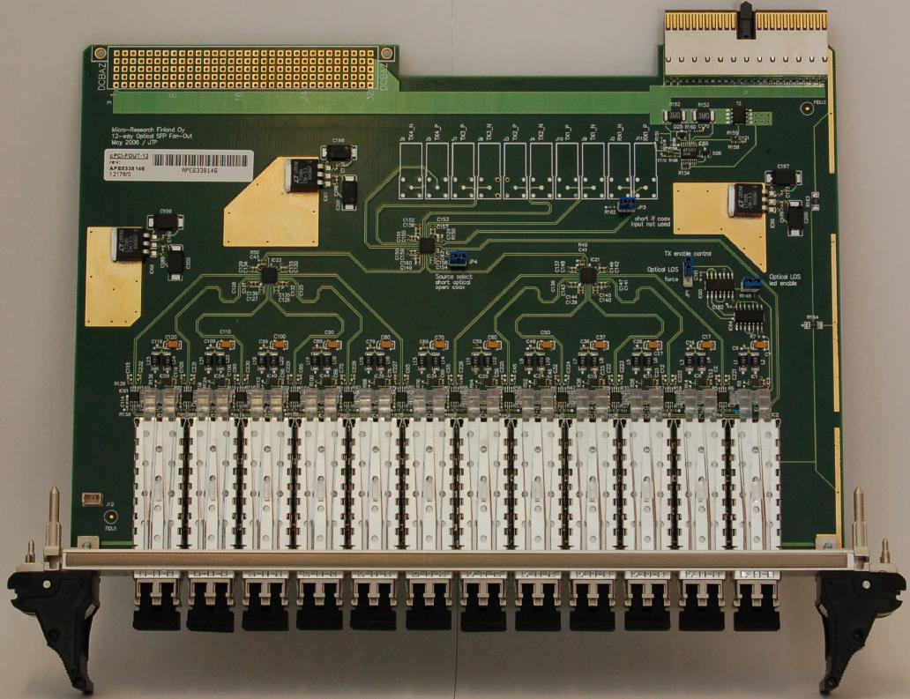
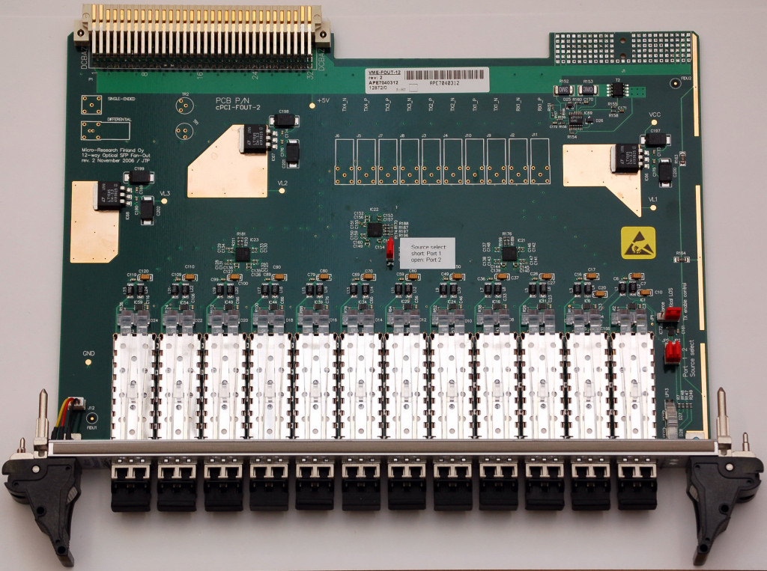
Micro-Research Finland Oy
cPCI-FOUT-12 / VME-FOUT-12
Due to requests a new batch of cPCI-FOUT-12 / VME-FOUT-12 Fan-Outs for 230 Series Hardware was produced
Available now

Slide 3
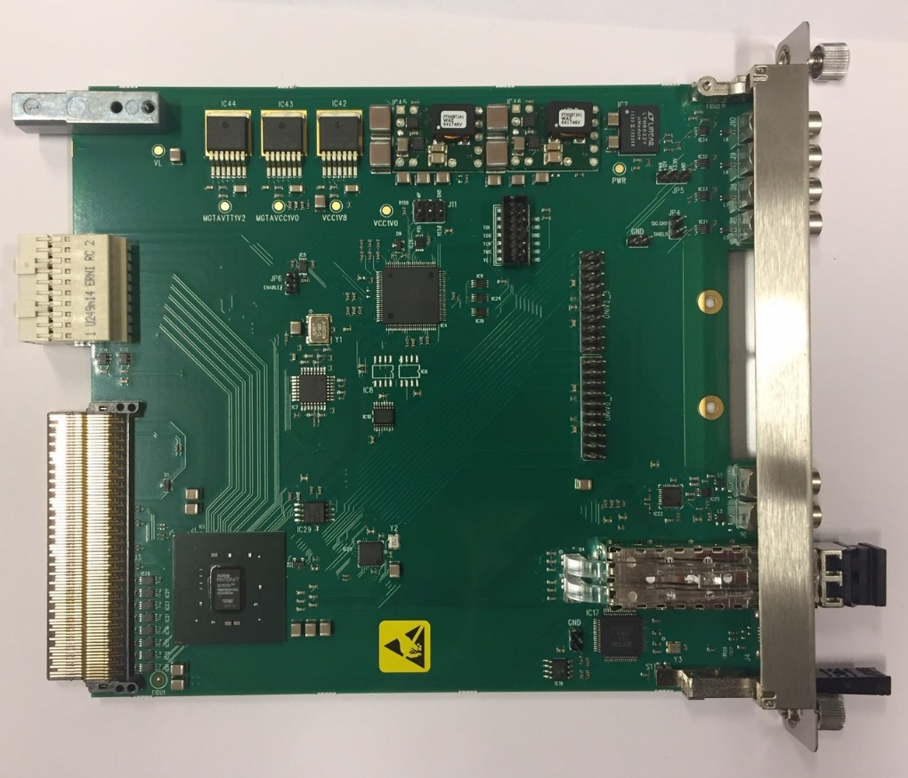
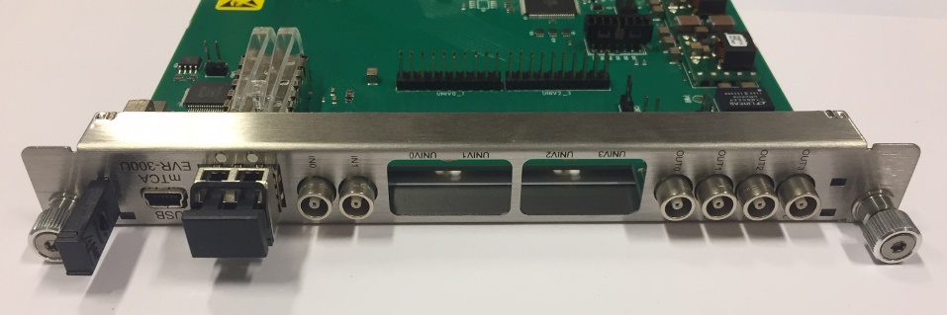
Micro-Research Finland Oy
mTCA-EVR-300GTX
New product coming up (first batch May 2026)
Similar to mTCA-EVR-300U (in photo)
  Both Universal I/O slots driven by two GTX outputs, four GTX outputs in total
  GTX outputs support fine tuning delay with 1/2560 event clock resolution (~3 ps @ 125 MHz)

Slide 4
Micro-Research Finland Oy
Firmware Changes
New EVM features
Added port specific shutters for the upstream ports separately for both events and DBUS bits (version 13)
New EVR features
Fast Event bypassing Delay Compensation FIFO (version 24)
Support of fine delays for VME-EVR-300 GTX outputs, delay adjustable with 1/2560 event clock cycle precision (~3 ps @ 125 MHz event clock) (will be available from version 12250207)

Slide 5
Micro-Research Finland Oy
VME SAM3X Microcontroller Firmware
By Sebastian Marsching (KIT)
Applies to VME-EVM-300 and VME-EVR-300
Improved UDP support
  32 bit read/write operations
  Improved reliability and speed
Added support for JTAG XVC Server (remote FPGA firmware upgrade over ethernet)
Upgrading of FPGA firmware required:
  VME-EVR-300 version 12260207 (not yet released)
  VME-EVM-300 version 22140207 (not yet released)

Slide 6
Micro-Research Finland Oy
Fast Event – Delay Compensation
Target delay 1 μs (~200 m)
80 m
EVR
DC FIFO delay 350 ns
50 m
EVM
EVM
150 m
EVR
DC FIFO delay 250 ns
75 m
30 m
EVR
EVM
DC FIFO delay 475 ns
50 m
EVR
DC FIFO delay 375 ns
*) This example does not take EVM/EVR internal latencies into account

Slide 7
Micro-Research Finland Oy
Fast Event – Operating Modes
Fast Event Disabled
  All events go through DC FIFO
Fast Event Enabled – High Priority Fast Event
  Fast event processed immediately after reception, bypasses DC FIFO
  All other events go through DC FIFO and can be delayed by one cycle
  Risk of losing event in case there is more than one fast event and a continuous train of other events
Fast Event Enabled – Low priority Fast Event
  Fast event gets processed as fast as possible waiting for empty event slot from events from the DC FIFO
  Timing of non-fast events is not altered

Slide 8
Micro-Research Finland Oy
Fast Event – Normal Mode
RX
Mapping RAM
DC FIFO
Fast Event
detection
1 Event
buffer

Slide 9
Micro-Research Finland Oy
Fast Event – Fast Event Mode
Fast Event detected, no event from DC FIFO
RX
Mapping RAM
DC FIFO
N/A
Fast Event
detection
1 Event
buffer

Slide 10
Micro-Research Finland Oy
Fast Event – Fast Event High Priority Mode
Fast Event detected, simultaneous event from DC FIFO
RX
Mapping RAM
DC FIFO
XX
Fast Event
detection
1 Event
buffer

Slide 11
Micro-Research Finland Oy
Fast Event – Fast Event High Priority Mode
Fast Event processed, events from DC FIFO delayed
RX
Mapping RAM
DC FIFO
XX
Fast Event
detection
1 Event
buffer

Slide 12
Micro-Research Finland Oy
Fast Event – Fast Event High Priority Mode
Return to normal mode after gap from events from DC FIFO
RX
Mapping RAM
DC FIFO
Fast Event
detection
1 Event
buffer

Slide 13
Micro-Research Finland Oy
Fast Event – Fast Event Low Priority Mode
Fast Event and simultaneous events from DC FIFO
RX
Mapping RAM
DC FIFO
Fast
Fast Event
detection
1 Event
buffer

Slide 14
Micro-Research Finland Oy
Fast Event – Fast Event Low Priority Mode
Fast event processed in gap from events from DC FIFO
RX
Mapping RAM
DC FIFO
Fast
Fast Event
detection
1 Event
buffer

Slide 15
Micro-Research Finland Oy
Fast Event – Fast Event Low Priority Mode
Return to normal mode after processing Fast Event
RX
Mapping RAM
DC FIFO
Fast Event
detection
1 Event
buffer

Slide 16
Micro-Research Finland Oy
Fast Event – Example with FIFO depth of 5 events
Received Event | Normal Mode | Fast Event High Priority | Fast Event Low Priority
0x00 | 0x00 | 0x00 | 0x00
0x01 | 0x00 | 0x00 | 0x00
0x02 | 0x00 | 0x00 | 0x00
0x03 | 0x00 | 0x00 | 0x00
0x04 | 0x00 | 0x00 | 0x00
0x05 | 0x00 | 0x00 | 0x00
0x00 | 0x01 | 0x01 | 0x01
0x00 | 0x02 | 0x02 | 0x02
0x00 | 0x03 | 0x03 | 0x03
0xFE | 0x04 | 0xFE | 0x04
0x00 | 0x05 | 0x04 | 0x05
0x00 | 0x00 | 0x05 | 0xFE
0x00 | 0x00 | 0x00 | 0x00
0x00 | 0x00 | 0x00 | 0x00
0x00 | 0xFE | 0x00 | 0x00
0x00 | 0x00 | 0x00 | 0x00
0x00 | 0x00 | 0x00 | 0x00

Slide 17
Micro-Research Finland Oy
Fast Event – Example with FIFO depth of 5 events (dropped events)
Received Event | Normal Mode | Fast Event High Priority | Fast Event Low Priority
0x00 | 0x00 | 0x00 | 0x00
0x01 | 0x00 | 0x00 | 0x00
0x02 | 0x00 | 0x00 | 0x00
0x03 | 0x00 | 0x00 | 0x00
0x04 | 0x00 | 0x00 | 0x00
0x05 | 0x00 | 0x00 | 0x00
0x00 | 0x01 | 0x01 | 0x01
0x00 | 0x02 | 0x02 | 0x02
0x00 | 0x03 | 0x03 | 0x03
0xFE | 0x04 | 0xFE | 0x04
0xFE | 0x05 | 0xFE | 0x05
0x00 | 0x00 | 0x05 | 0xFE
0x00 | 0x00 | 0x00 | 0x00
0x00 | 0x00 | 0x00 | 0x00
0x00 | 0xFE | 0x00 | 0x00
0x00 | 0xFE | 0x00 | 0x00
0x00 | 0x00 | 0x00 | 0x00

